Slide 1
R for statistics day 2 Tidy data Graphing with ggplot Linear models
George Savva (QIB)
January 2020

Slide 2
Today’s work
Instructor led walk through plus discussion
Typical analysis:
Tidy data
Graphing and descriptives
Linear modelling
You have:
Data file (walkingspeed2.xlsx)
Slides
Handouts
Rmarkdown (.rmd) files to generate the handouts
R scripts derived from these with the code for the session.
Today’s order!
Graphing and descriptives
Linear modelling
Tidy data

Slide 3

Data management

Slide 4
Cleaning and coding using R scripts
Your data is likely to need some cleaning and coding before analysis
Do not change your raw data.
Do your management, cleaning and coding in your R script, not in the data file itself
But do record your data sensibly in the first place, remembering that you’ll need to import it into a stats package.
This means:
You have a clear audit trail with explanations in comments
And you can easily undo if you make a mistake

Slide 5
Combing and cleaning – extract from my own code
## Load and combine the data
preData <- read_excel(path="NEC4.xlsx", sheet="Pre probiotics", range="A1:AD470")
postData <- read_excel(path="NEC4.xlsx", sheet="Post probiotics", range="A1:AD514")
# Combine data from pre- and post- together.
allData <- rbind(preData, postData)
## These were the two that Paul said he
## changed to not VON. Currently set to VON
allData$NEC_VON[allData$id==391] <- 0
allData$NEC_VON[allData$id==1493] <- 0
Loading data into two data frames
Combining the two data frames into one ‘longer’ one
Fixing some values that the CI said needed to be changed

Slide 6
Some unhelpful but common practices
Things to avoid in data entry..
Colour coding.
Leaving text notes in numerical fields.
Repeating variable names
Multiple rows of column header
Merged cells
Spaces in column names
We cannot load data like this into a data frame
Patient | Pre-treatment |  | Post-treatment
Number | Pain | Quality of life | Pain | Quality of life
1 | 2 | 1 | 4 | 3
2 | 3 | 3 | 2 | 4
3 | 2 | DK | 4 | 2
4 | 4 | about 2 | 5 | 1
5 | 5 | 2 | 3 | 5
6 | 2 | 1 | 3 | 6
7 | 1 | 5 | 5 | 3
 |  |  |  | Female

Slide 7
Better (tidy) data entry setup
Better - long
Patient | Pre-treatment |  | Post-treatment
Number | Pain | Quality of life | Pain | Quality of life
1 | 2 | 1 | 4 | 3
2 | 3 | 3 | 2 | 4
3 | 2 | DK | 4 | 2
4 | 4 | about 2 | 5 | 1
5 | 5 | 2 | 3 | 5
6 | 2 | 1 | 3 | 6
7 | 1 | 5 | 5 | 3
 |  |  |  | Female
PatNo | Sex | Time | Pain | QOL | Notes
1 | M | Pre | 2 | 1
2 | M | Pre | 3 | 3
3 | M | Pre | 2 |  | QOL score don't know
4 | M | Pre | 4 | 2 | QOL score is approximate
5 | M | Pre | 5 | 2
6 | F | Pre | 2 | 1
7 | F | Pre | 1 | 5
1 | M | Post | 4 | 3
2 | M | Post | 2 | 4
3 | M | Post | 4 | 2
4 | M | Post | 5 | 1
5 | M | Post | 3 | 5
6 | F | Post | 3 | 6
7 | F | Post | 5 | 3
Better - wide
PatNo | Sex | Pain1 | QOL1 | Pain2 | QOL2 | Notes
1 | M | 2 | 1 | 4 | 3
2 | M | 3 | 3 | 2 | 4
3 | M | 2 | DK | 4 | 2
4 | M | 4 | 2 | 5 | 1 | QOL1 is approximate
5 | M | 5 | 2 | 3 | 5
6 | F | 2 | 1 | 3 | 6
7 | F | 1 | 5 | 5 | 3
Tidy data:
One row per unit of observation
One column per variable
Valid column names
Single ‘type’ in each column

Slide 8
Why tidy data?
Databases like to represent data in rectangles like this.
Tidy data allows us to describe relationships between our variables in simple terms:
Pain ~ Sex + Time + Patno
And estimating those relationships is really all a statistical analysis is!
PatNo | Sex | Time | Pain | QOL | Notes
1 | M | Pre | 2 | 1
2 | M | Pre | 3 | 3
3 | M | Pre | 2 |  | QOL score don't know
4 | M | Pre | 4 | 2 | QOL score is approximate
5 | M | Pre | 5 | 2
6 | F | Pre | 2 | 1
7 | F | Pre | 1 | 5
1 | M | Post | 4 | 3
2 | M | Post | 2 | 4
3 | M | Post | 4 | 2
4 | M | Post | 5 | 1
5 | M | Post | 3 | 5
6 | F | Post | 3 | 6
7 | F | Post | 5 | 3

Slide 9
Reshaping (long <--> wide)
Correlations need this wide form
PatNo | Sex | Pain1 | QOL1 | Pain2 | QOL2
1 | M | 2 | 1 | 4 | 3
2 | M | 3 | 3 | 2 | 4
3 | M | 2 |  | 4 | 2
4 | M | 4 | 2 | 5 | 1
5 | M | 5 | 2 | 3 | 5
6 | F | 2 | 1 | 3 | 6
7 | F | 1 | 5 | 5 | 3
pivot_longer()
ggplot2 or lm needs this ‘long’ form…
PatNo | Sex | Time | Pain | QOL
1 | M | Pre | 2 | 1
2 | M | Pre | 3 | 3
3 | M | Pre | 2
4 | M | Pre | 4 | 2
5 | M | Pre | 5 | 2
6 | F | Pre | 2 | 1
7 | F | Pre | 1 | 5
1 | M | Post | 4 | 3
2 | M | Post | 2 | 4
3 | M | Post | 4 | 2
4 | M | Post | 5 | 1
5 | M | Post | 3 | 5
6 | F | Post | 3 | 6
7 | F | Post | 5 | 3
pivot_wider()

Slide 10
Combining datasets
Our data often comes in different parts that we’ll need to combine, or in a different shape to what we ideally need:
So we often need to merge or combine data sources first
We might also need to ‘reshape’ data
We can also ‘subset’ (‘filter’) data, ie only analyse or plot a certain number of observations…

Slide 11
Combining datasets
Three main ways to combine datasets
rbind() – ‘row bind’ adding more observations
merge() – combining data by IDs

Slide 12
rbind - row binding, appending
rbind():
Adding rows together to make a longer dataset
Column headings must be exactly the same in both frames

Slide 13
merge
Adding new columns based on matching ‘key’ columns
metadata
Patient | Sex | Group
1 | M | Treat
2 | F | Control
merge(results, metadata, by="Patient")
Patient | Time (h) | Outcome | Sex | Group
1 | 0 | 0.950443 | M | Treat
1 | 2 | 0.284424 | M | Treat
1 | 4 | 0.988397 | M | Treat
1 | 6 | 0.171121 | M | Treat
2 | 0 | 0.484535 | F | Control
2 | 2 | 0.697376 | F | Control
2 | 4 | 0.312342 | F | Control
2 | 6 | 0.349255 | F | Control
results
Patient | Time (h) | Outcome
1 | 0 | 0.9504432
1 | 2 | 0.2844238
1 | 4 | 0.9883974
1 | 6 | 0.1711207
2 | 0 | 0.4845351
2 | 2 | 0.6973757
2 | 4 | 0.3123415
2 | 6 | 0.3492549

Slide 14
Worked Example – Data management
Typical scenario.
Data is in two excel sheets, with mismatched names.
Important meta-data is in a third sheet
We need it all in a single data frame for analysis
Tasks to get the data ready for analysis
Load both datasets into separate data frames
Rename the columns to make them consistent
Combine the data sets into a single frame
Load the meta-data and merge it into the main data
Data for this exercise is in walkingspeed2.xlsx

Slide 15
Rbind and merge
Open ‘walkingspeed2.xlsx’ in Excel and look around.
Treatment and control participants are on separate sheets.
Meta-data is in a third sheet
Which commands do we need to get these into a single usable sheet?
We’ll rbind() the data into a single dataframe
Then merge() in the meta data.

Slide 16
ggplot2 & Grammar of Graphics

Slide 17

ggplot2 vs ‘base’ graphics
Base graphics
Simple to use
Complicated to adjust
ggplot2 (since 2005)
By Hadley Wickham
Slightly more complicated to set up
Very powerful
Now at version 3
Suggestions: Learn ggplot2!
But remain aware of the ‘base’ plotting options

Slide 18
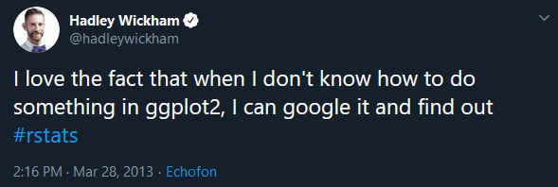
How to learn ggplot2
Learn the structure of ggplot2 graphs.
If you’re stuck, look at a book, official documentation or a vignette
ggplot2 versions differ, so older StackExchange answers or guides might not be the best way to do things.
Also people tend to write low quality answers to ggplot2 questions

Slide 19
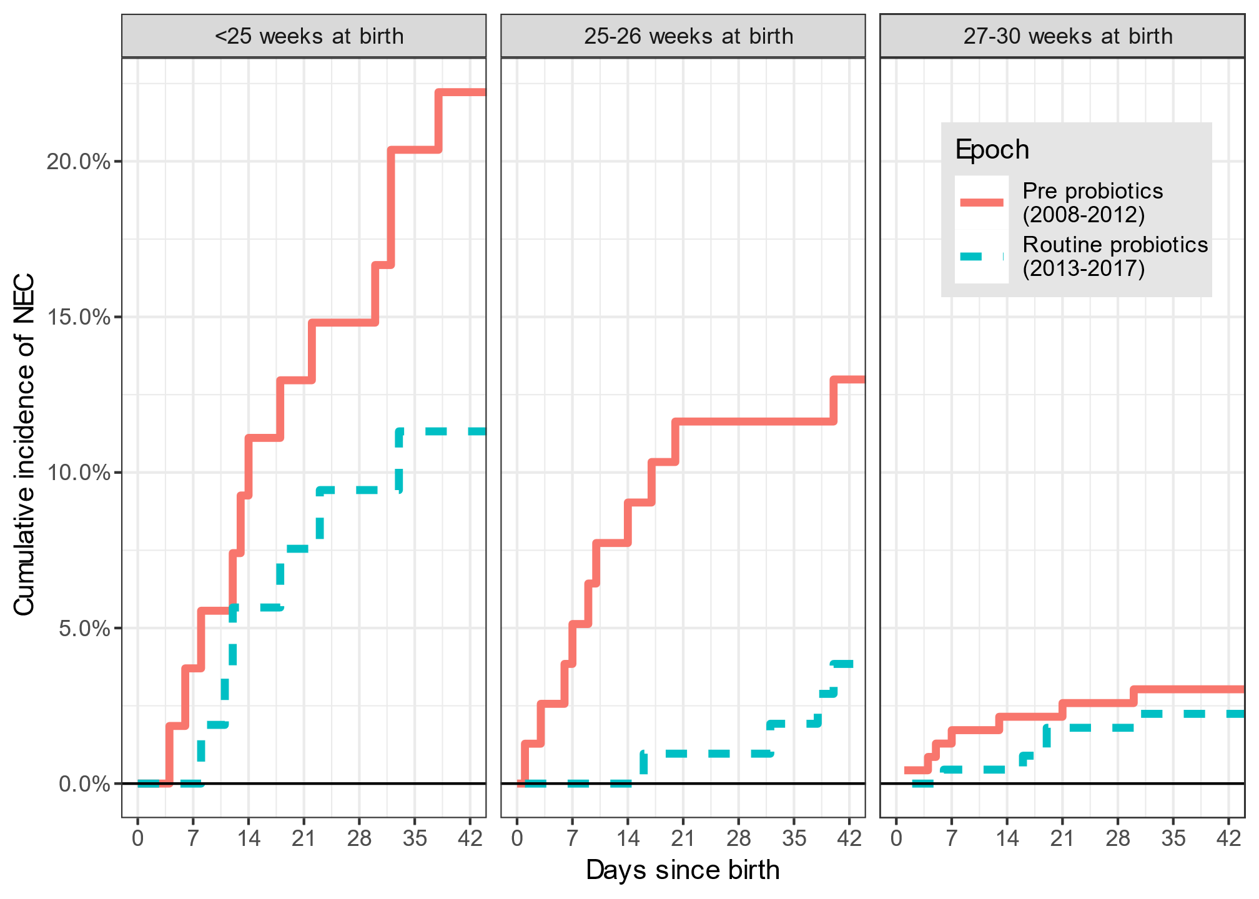
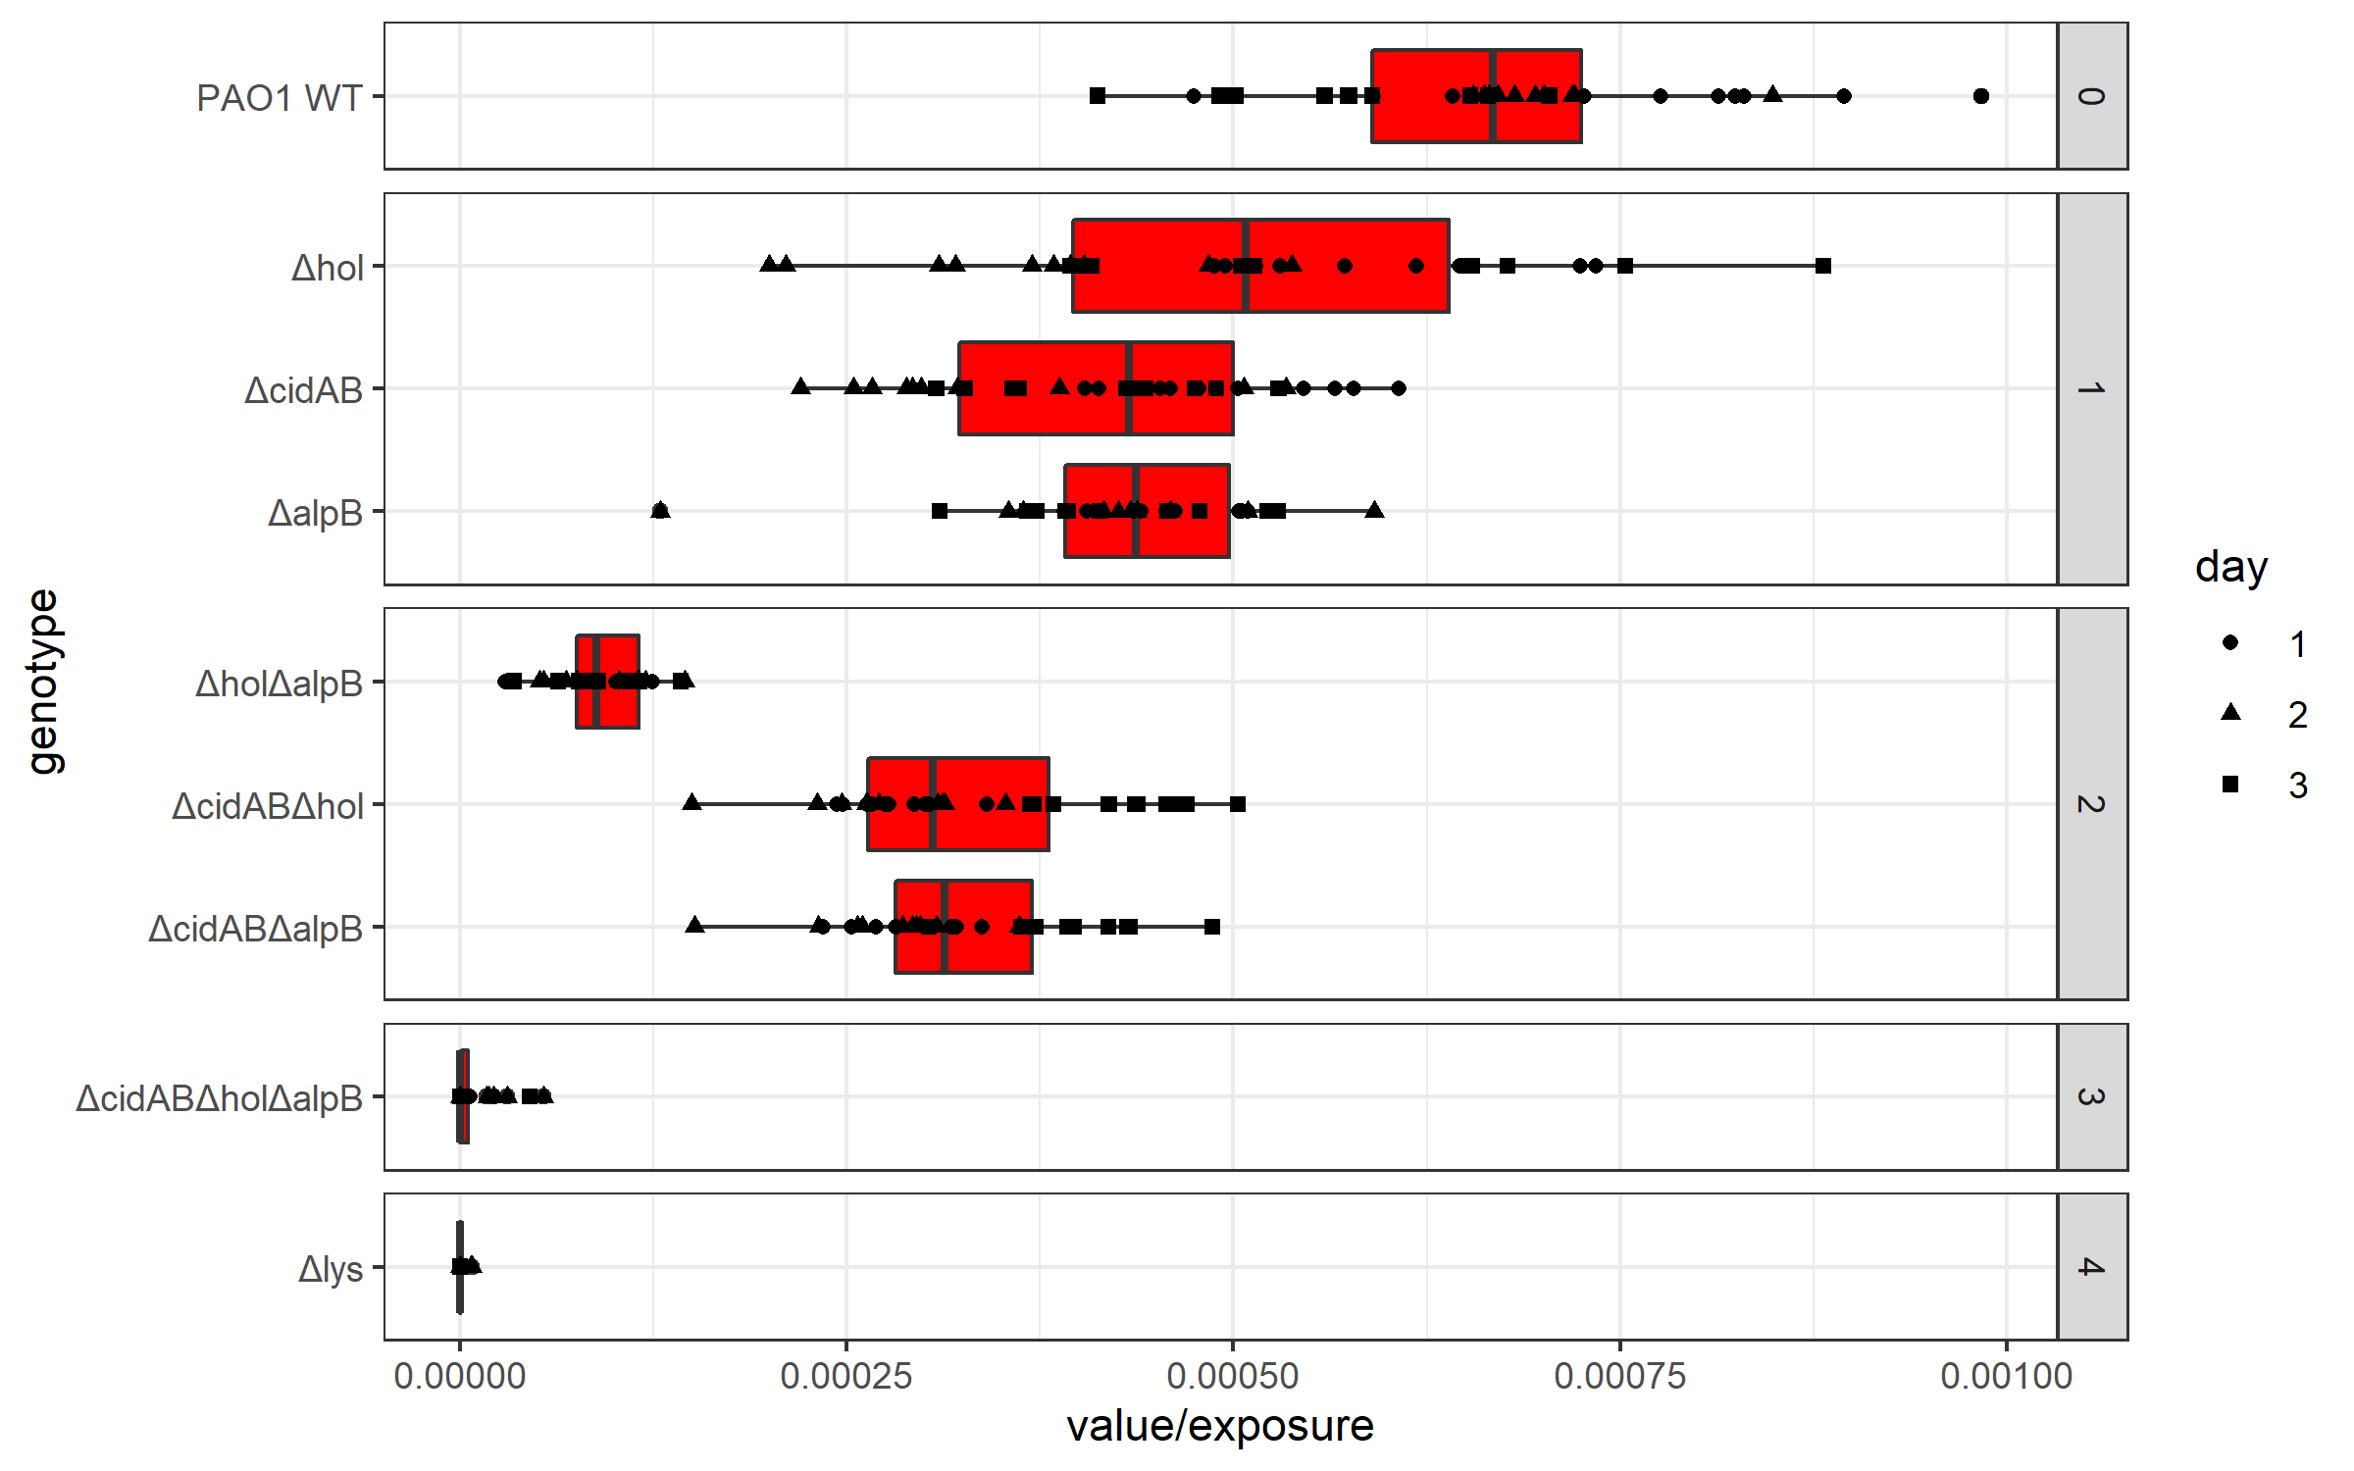
Some graphs I’ve made
Horizontal plots can be easier to read than vertical ones
Can use Unicode characters (here Greek)
Easy faceting and good control of legends

Slide 20
Some graphs I’ve made
Using ‘ggrepel’ labels will avoid points and each other

Slide 21
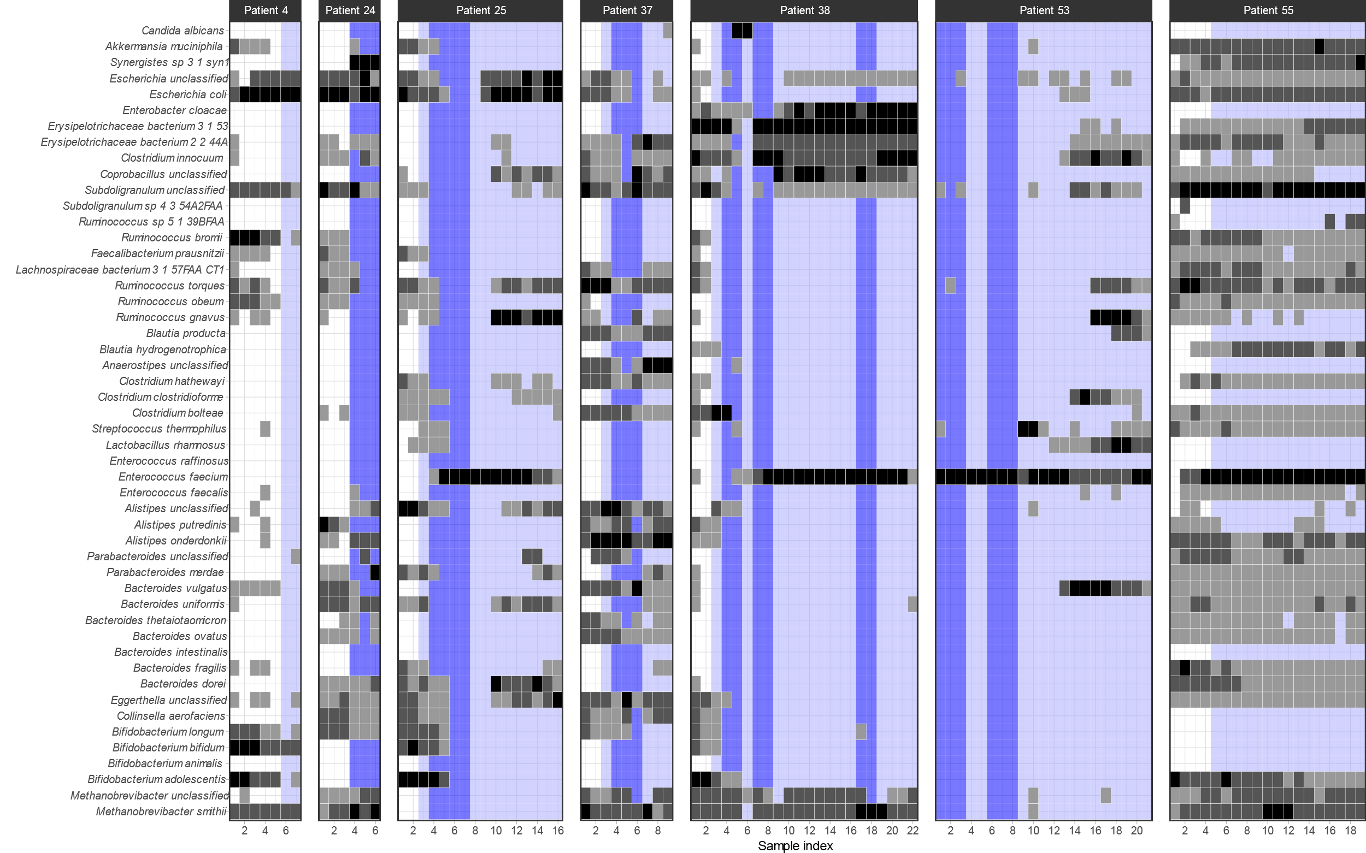
heatmaps

Slide 22
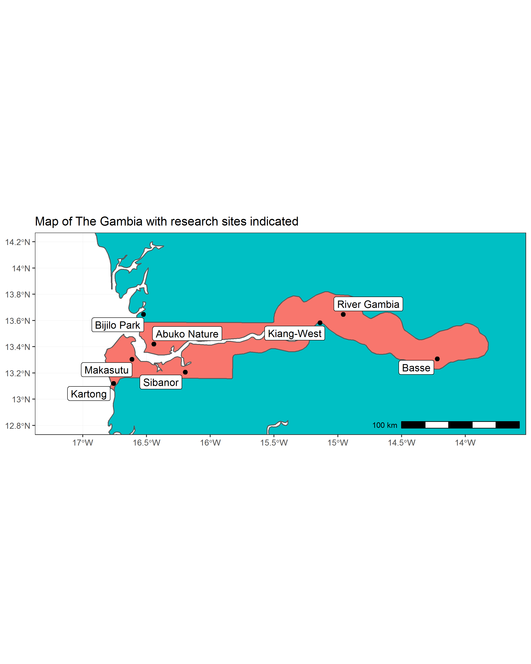
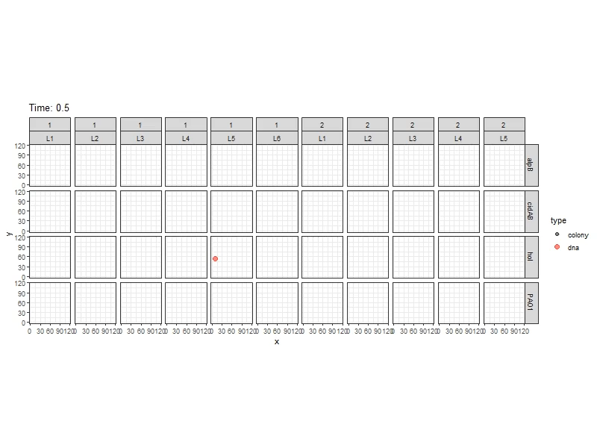
ggplot extensions:
sf
gganimate (by Tomas Lin Pedersen)

Slide 23
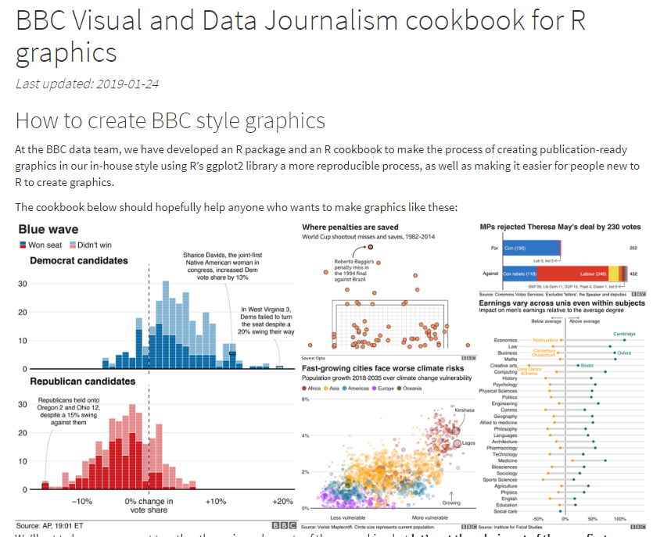
https://bbc.github.io/rcookbook/
The BBC and FT now only use R and ggplot2 to make their graphics

Slide 24
Common grammar of graphics
How does ggplot2 work?
You describe the components of the graph you want in code
Using a ‘grammar’ that describes how your data should be presented.
ggplot2 implements this idea for R

Slide 25
Aesthetic mapping
The central idea of ggplot is aesthetic mapping
Aesthetic mapping
Aesthetics
Data
sex
x
age
y
patid
color
treated
size
time
shape

Slide 26
Elements of ggplot2 grammar
Data – which data frame to use
Aesthetic mapping – how the variables in your data map onto the graph and graph objects
Geometric objects – what objects represent the data (box, line, point etc)
Scales – how should values be mapped and labelled
Facets – stratification of the graph
Statistics – eg means, counts or standard errors
Coordinates –the dimensions of the plot
Labels – how should the aesthetics be labelled
Theme – extra detail about the look

Slide 27
Step 1 - data
Choose the data frame that you want to use:
ggplot(alldata)
This won’t do anything useful by itself

Slide 28
Step 2 – aesthetic mapping
Aesthetic mapping:
How are the columns in your data represented on your graph
First decide which variables will be represented on the x and y axes:
ggplot(alldata, aes(x=treated, y=time))
What did it do?

Slide 29
Step 3 – add a ‘geom’
Add a geometric object:
ggplot(alldata, aes(x=treated, y=time)) + geom_point()
What has ggplot done? What do you notice about the data?
Note the ‘+’ used to ‘add’ gg objects. This is how we add elements together.
To investigate outliers, changing the scale could be a good idea…

Slide 30
Remove the outliers and the missing data
Remove the outliers by setting their values to NA
Could use ‘remove_missing()’ function in ggplot2.
But we’ll use subset here:
alldata <- subset( alldata , !is.na(treated) )
Use of subset():
subset(data, condition)

Slide 31
Aesthetic mapping
ggplot(alldata, aes(x=treated, y=time)) + geom_point()
Data
Aesthetics used by geom_point
sex
x
age
y
patid
color
treated
Aesthetic mapping
size
time
shape
ggplot(alldata) + geom_point(aes(x=treated, y=time))
qplot(x=treated, y=time, data=alldata, geom=“point”)

Slide 32
geom’s that I use a lot
Geometric object | Use
geom_point | Points (scatter plot)
geom_line | Lines
geom_boxplot | Box plots
geom_errorbar / geom_pointrange | Error bars
geom_bar / geom_histogram / geom_col | Histograms or bar graphs
geom_tile / geom_raster | Heatmaps
geom_text / geom_label | Text labels within the graph area
geom_beeswarm | ‘Beeswarm’ graphs
geom_label_repel / geom_text_repel | Text and labels that ‘get out of the way’

Slide 33
Which aesthetics do they need or use?
Geometric object | Possible aesthetics. Needed = bold.
geom_point | x, y, alpha, colour, fill, group, shape, size, stroke
geom_line / geom_path / geom_step | x, y, alpha, colour, linetype, size, group
geom_boxplot | x, (y), lower, upper, middle, ymin, ymax, alpha, colour, fill, group, linetype, shape, size, weight
geom_errorbar / geom_pointrange | x, (y), ymin, ymax, size, linetype, colour, width, alpha
geom_histogram / geom_bar | x, y, alpha colour, fill, group, linetype, size
geom_tile / geom_raster | x, y, alpha, colour, fill, group, height, linetype, size, width
geom_text / geom_label | x, y, label, alpha, colour, fill, group, shape, size, stroke
geom_beeswarm | same as geom_point
geom_label_repel / geom_text_repel | same as geom_text

Slide 34
Step 4 – Change the scale
Add a scale function:
ggplot(alldata, aes(x=treated, y=time)) + geom_point() + scale_y_log10()
What has changed? What do you notice now?
(Go to calculating ‘speed’ and fixing the outliers)
Note how I’ve split the command over lines to make it easier to read.
You must leave the + at the end of each line, (or otherwise indicate the command isn’t finished).

Slide 35
Exercises
Exercise 1
Make a scatter plot of time vs age
Change this plot to make the shape of each point reflect the treatment
Exercise 2
Make a box plot of time by sex, with a different coloured box per sex
Add the individual points back on top of the boxplot using a points (or beeswarms, for which you’ll need to install the ggbeeswarm package)

Slide 36
4 - Scales
How do the values in the data map to the literal values in each aesthetic? Eg:
Using a logarithmic scale:
scale_x_continuous(breaks=c(1,2,3,4,5))
scale_y_log10()
Picking more visually appealing colours for continuous or discrete scales:
scale_color_brewer()
scale_fill_manual(values=c(“red”,”blue”,”green”))

Slide 37
5 – Facets
Stratify the plot using variables in your dataset
facet_wrap() is easier to use
facet_grid() gives you more control in more dimensions
ggplot(alldata, aes(x=treated, y=time)) + geom_boxplot() + scale_y_log10() + facet_wrap(~sex)

Slide 38
6 - Summary statistics
As well as the raw data we can add summaries.
Add (for example) means and standard error.
+ stat_summary( geom=“bar”, fun.y=mean ) +
stat_summary( geom=“errorbar”, fun.data=mean_se )
A scatter plot can take stat_smooth() to add a lowess or regression line.

Slide 39
Adding p-values (if you must)
The ‘ggpubr’ library has a nice way to add p-values to a plot:
(note the switch to plotting the ‘speed’ variable)
install.packages("ggpubr")
library(ggpubr)
ggplot(alldata2, aes(x=treated, y=speed, fill=treated)) + geom_boxplot() + geom_beeswarm() + facet_wrap(~sex) + scale_fill_manual(values=c("red","green")) + stat_compare_means(method="t.test", comparisons = list(c("Control","Treat")))

Slide 40
8. Labels
Next, we’ll fix the labels:
ggplot(alldata2, aes(x=treated, y=speed, fill=treated)) + geom_boxplot() + geom_beeswarm() + facet_wrap(~sex, labeller=labeller(sex=c("Male", "Female")) + scale_fill_manual(values=c("red","green")) + stat_compare_means(method="t.test", comparisons = list(c("Control","Treat"))) + labs(x="Treatment", y="Walking speed (m/s) ", fill="Treatment")
# Notice that to assign variable labels, labs() labels the aesthetics (x, y, fill), not the variables themselves!
# On the other hand ‘labellers’ assigns value labels to variables

Slide 41
9. Themes…and done!
Control the overall look. I almost always use theme_bw() for publication graphs
Control individual elements with theme()
ggplot(alldata, aes(x=treated, y=time, fill=treated)) +
geom_boxplot() +
geom_beeswarm(cex=3) +
facet_wrap(~sex, labeller=labeller(sex=c(M="Male",F="Female"))) +
scale_fill_manual(values=c("red","green")) +
scale_y_log10() +
stat_compare_means(method="t.test", comparisons = list(c("Control","Treat"))) +
labs(x="Treatment", y="Walking speed (m/s) ", fill="Treatment") +
theme(legend.position = "none") + theme_bw()

Slide 42
A similar graph with ‘base’ graphics
par(mfrow=c(1,2))
boxplot(data=subset(alldata2, sex=="M"), speed ~ treated, col=c("red","green"), main="Male")
beeswarm(speed ~ treated, data = subset(alldata2, sex=="M"), add = TRUE, col = 'black', pch=20)
boxplot(data=subset(alldata2, sex=="F"), speed ~ treated, col=c("red","green"), main="Female")
beeswarm(speed ~ treated, data = subset(alldata2, sex=="F"), add = TRUE, col = 'black', pch=20)

Slide 43
Estimating Linear Models

Slide 44
What is a linear model?
A statistical model describing the relationship between the variables in your data.
Statistics is really just estimating models!
y = a + bx + e
Is the simplest model, describing a simple regression line – but is the starting point for most of statistics.

Slide 45
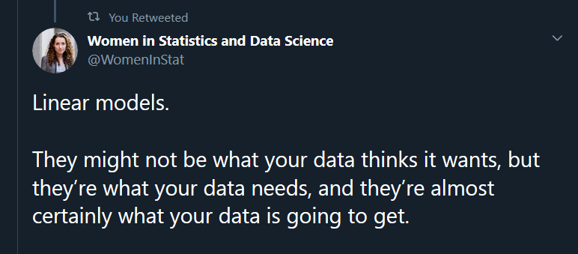
Why linear models?
Almost all statistical analysis / machine learning builds on linear models.

Slide 46
Linear models and R
R’s language is

Slide 47
Most stats methods should be framed as regression modelling
AVOVA / MANCOVA etc…
Binary outcomes
Correlations
Confounders and mediators
(Factor analysis and PCA)
Differential abundance
Gene expression
Spatial analysis
Survival analysis
Stochastic processes
Etc…
Y = a + bx + e
Outcome = Predictors + Error Struture
lm(y ~ x)
If you can write down the hypothesised relationships between your variables then you can estimate them.

Slide 48
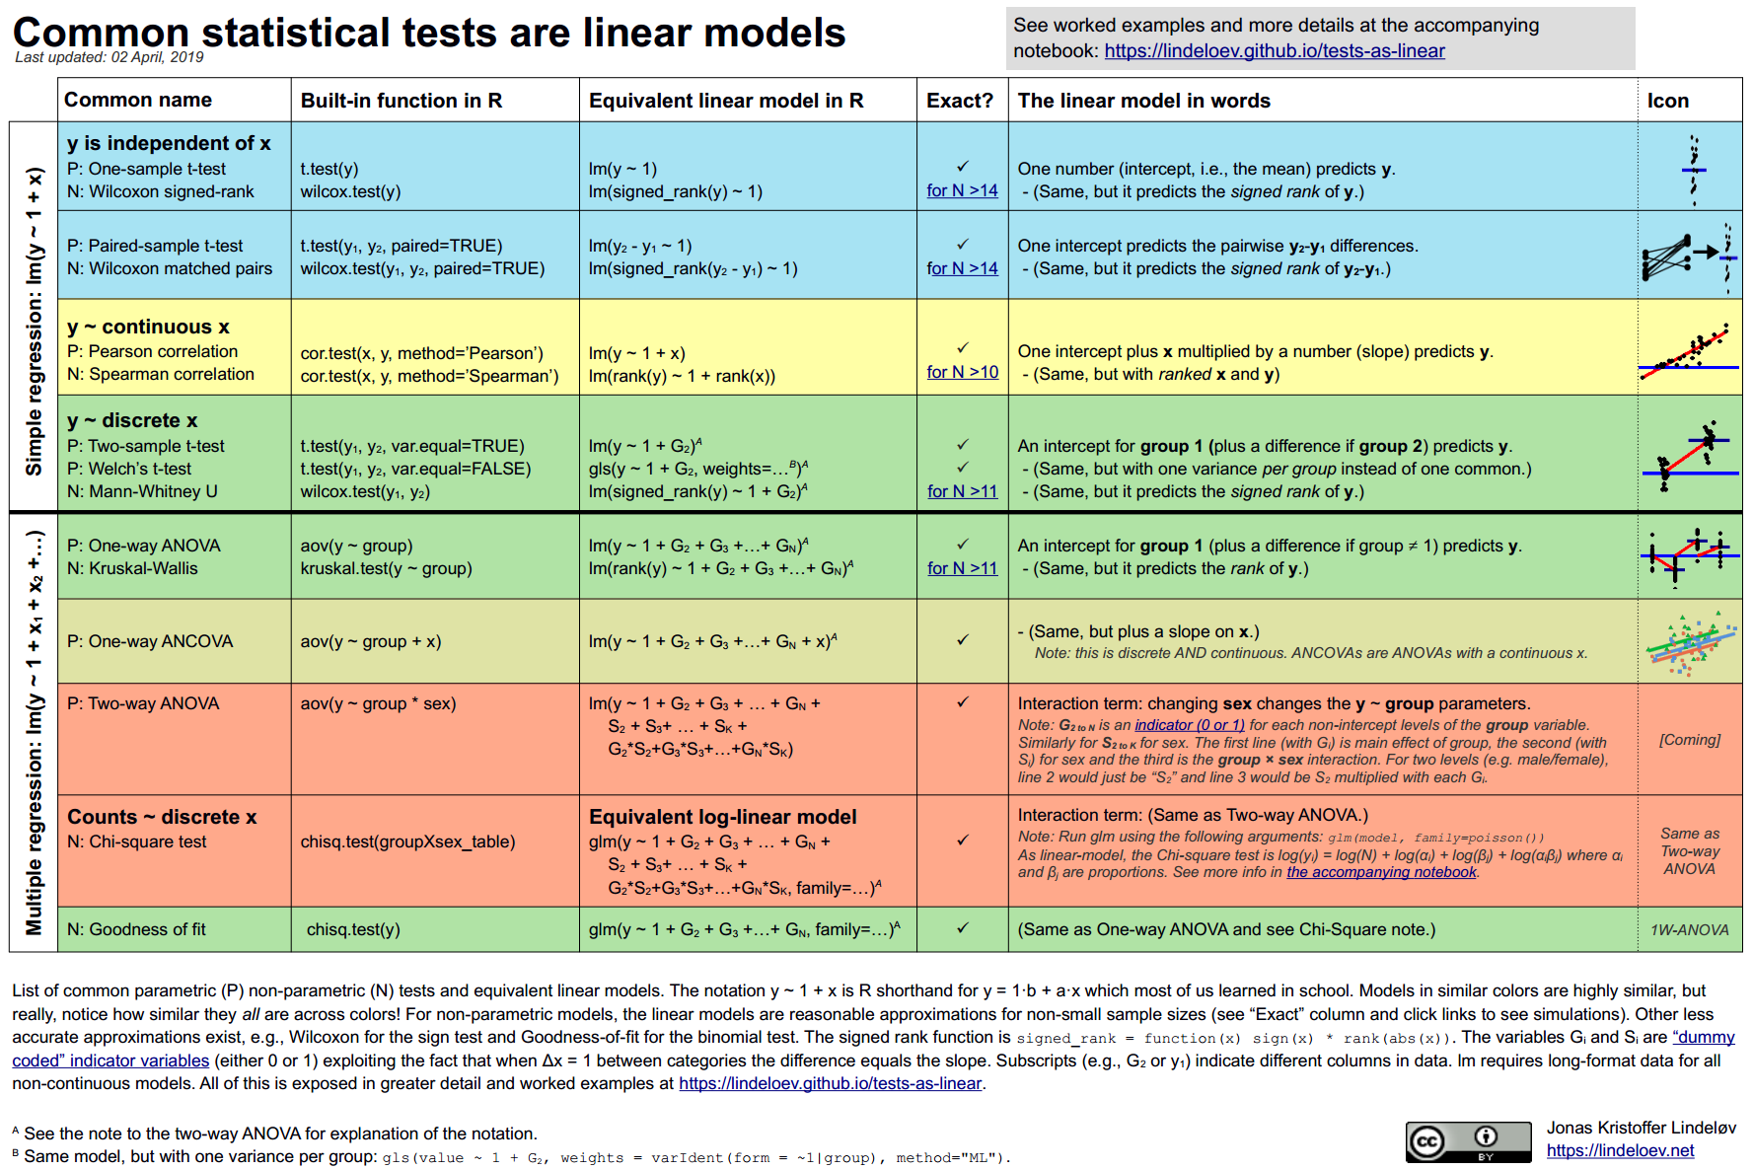
https://lindeloev.github.io/tests-as-linear/

Slide 49
Exercise
Worked example of estimating a linear model with lm() using walking speed data
Your own analysis using treedata

